Slide 1
The Exam System - Documentation Global Technology Legal Compliance
June 01, 2012
Confidential

Slide 2
Agenda
What is the Exam System?:
What it is
Implementation & Classes
Classes explained
Database
ERD
Frameworks and Tools Used

Slide 3
What is the Exam System?:
The Basics

Slide 4
What is it?
A web application to create and administer quizzes/tests/exams
Users will be able to:
Create user accounts
Create exam objects
Create question objects
Create answer objects
Associate them all together as the user see fits to create an exam
Take the created exams
Get immediate responses on whether or not their answers are correct
Keep track of the previous exams taken using the user control panel

Slide 5
Classes
There are a few

Slide 6
Every table in the Database has a class
Every table in the database has its own class
Along with basic getter/setters for every variable which a table row would have, each class has the ability to:
Grab all associated information using only a primary key
Save to the database
Delete from the database
Refer to the ER Diagram for the classes.

Slide 7
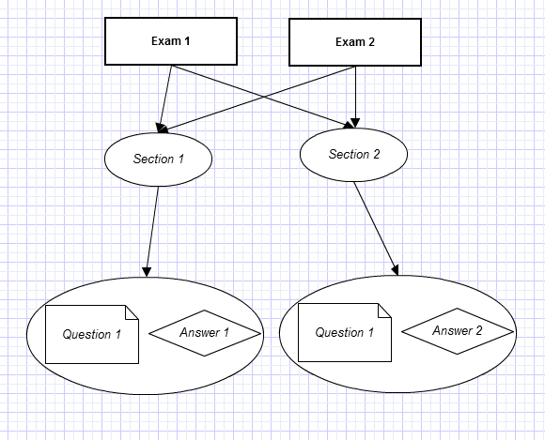
Exam Objects
It is necessary to understand how the systems objects (exams, sections, etc..) are related to one another in order to create proper exams.
Every exam can be linked with 0-many sections
Each section can be linked with multiple questions
Each question associated to any given section will be associated with an answer
This means that the same question existing in 2 different section can have differing answers
Example:
Question: Is this absence of color black or white?
The answer would depend on the section; if physics, black, if art, white

Slide 8
Database

Slide 9
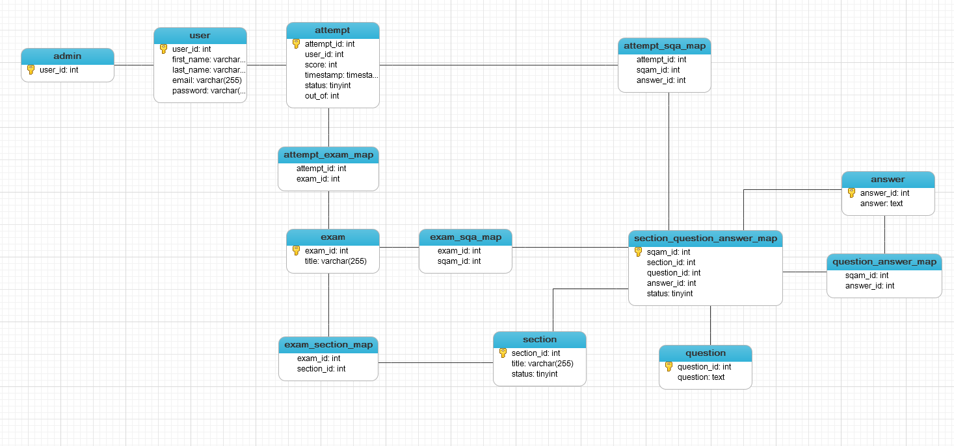
ER Diagram

Slide 10
Why It’s Designed Like This
The database was designed like this to solve several use cases:
An exam should be able to have multiple sections
Each section should be able to have multiple questions
Each question should be able to have several possible answers but only 1 correct one
A question associated with any given section should not be required to have the same answer as itself in another section:
ex:
Question: What color do you get if you mix every color together?
If this question was being asked in an “Art” section, the answer would be “Black”
If this question was being asked in a “Physics” section, the answer would be “White”

Slide 11
Frameworks and Tools Used

Slide 12
Frameworks/Libraries
The only library used was jQuery
All other functionality and usability is handcoded.

Slide 13
Thank You!
For more complete examples of what a context file should look like, as well as the actual XML Scema, please refer to this site:
https://tdwiki.pgdev.sap.corp/display/GTLC/Context+File+Requirement

